Slide 1
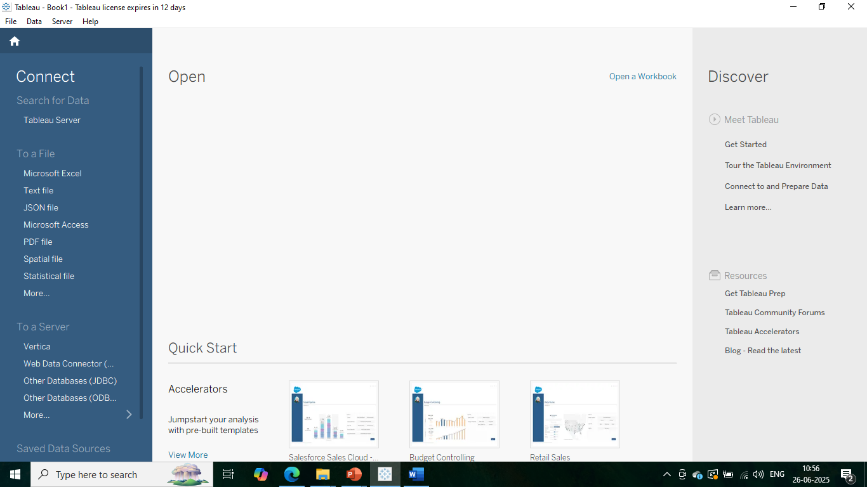
Step1) We opened the Tableau 2025.2 and start searching for file type to be selected.

Slide 2
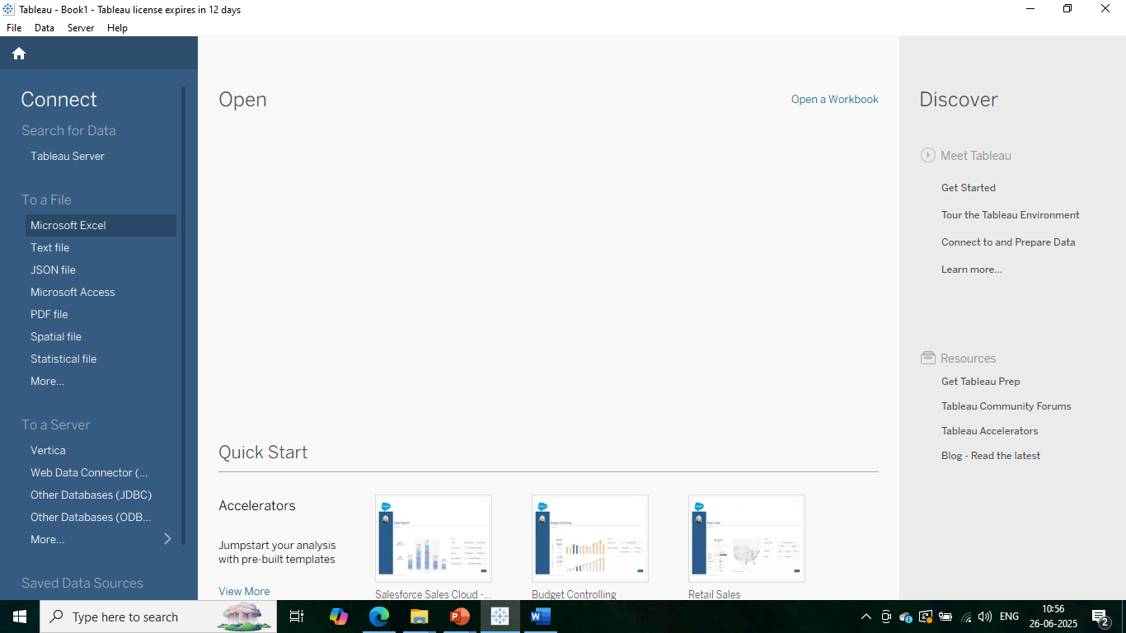
Step2) We go to Microsoft Excel Tab option to select csv file name Superstore.csv.

Slide 3
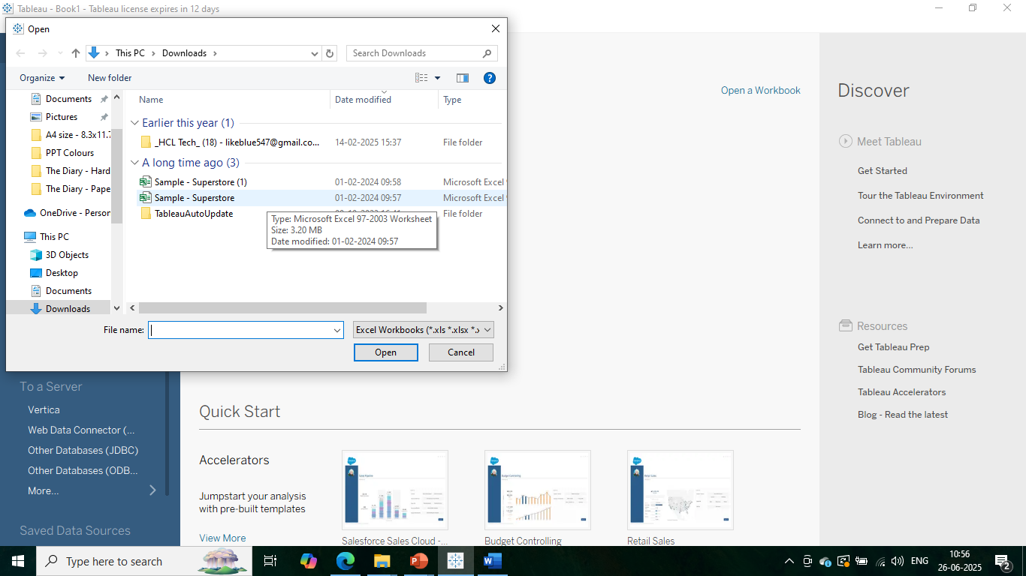
Step3) We selected file name Superstore.csv from the box.

Slide 4
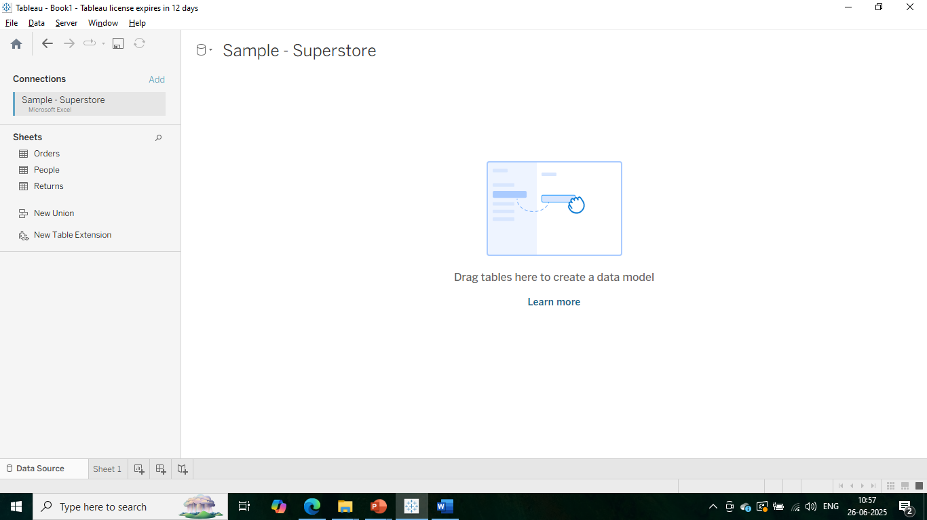
Step4) We landed on below shown page where all the tabs of csv file are shown.

Slide 5
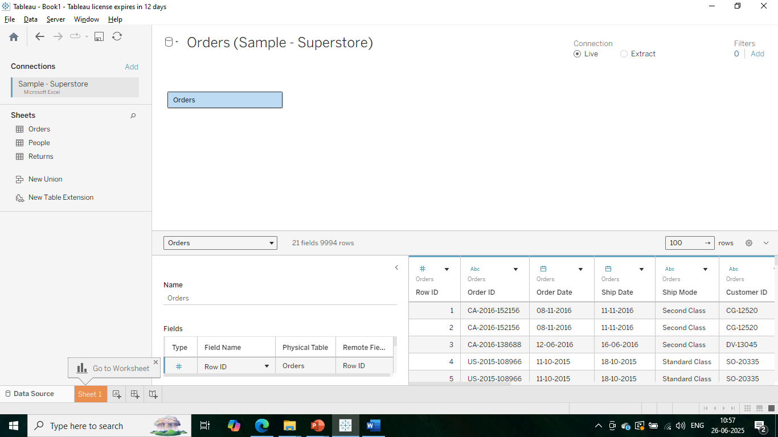
Step5) We dragged the Orders tabs of superstore sheet to the drop area..

Slide 6
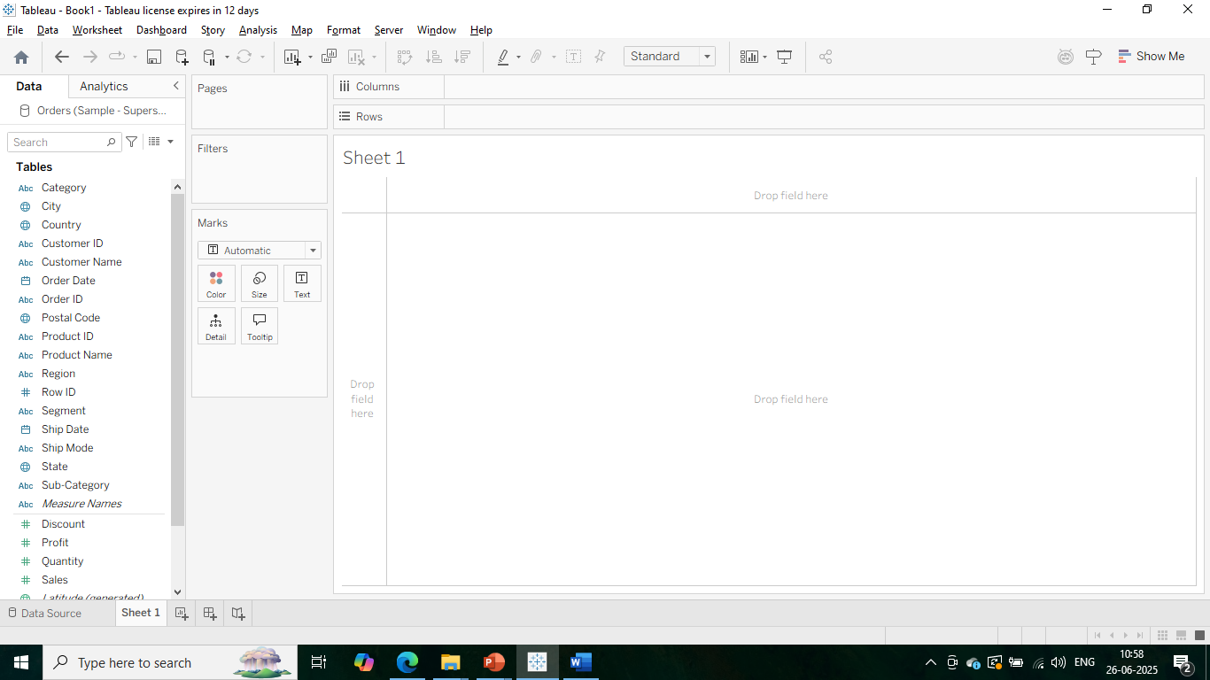
Step6) We go to the worksheet area to drag and drop fields to columns and rows..

Slide 7
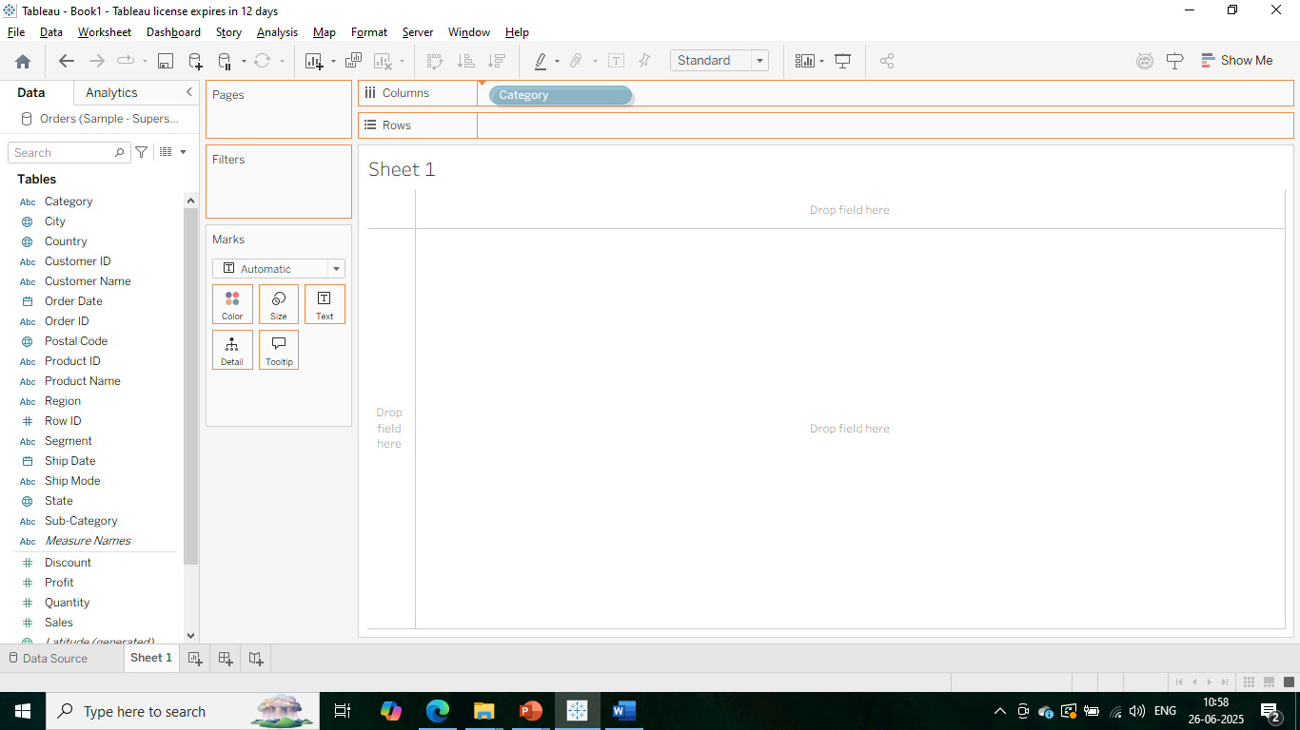
Step7) We dragged category to columns in worksheet 1.

Slide 8
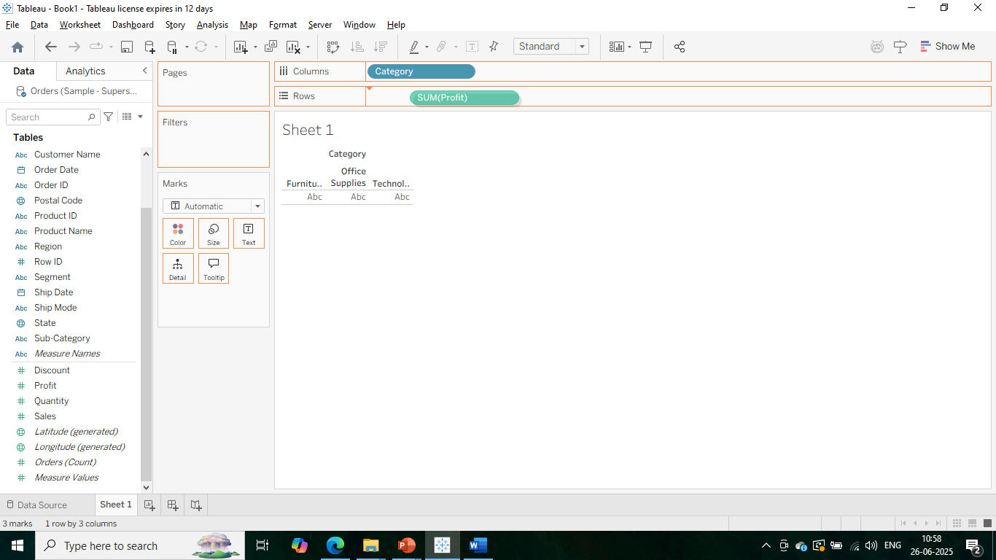
Step8) We dragged profit to rows in worksheet 1.

Slide 9
Step9) We dragged profit to rows in worksheet 1.

Slide 10
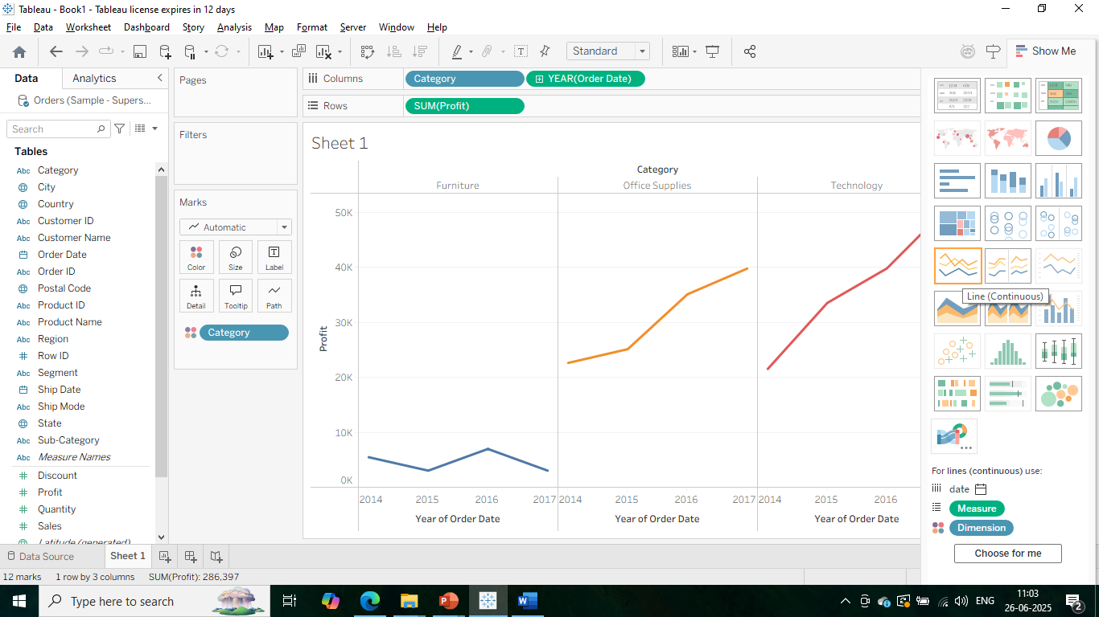
Step10) We dragged order date to columns in worksheet 1.

Slide 11
Step11) We selected the line chart for worksheet 1.

Slide 12
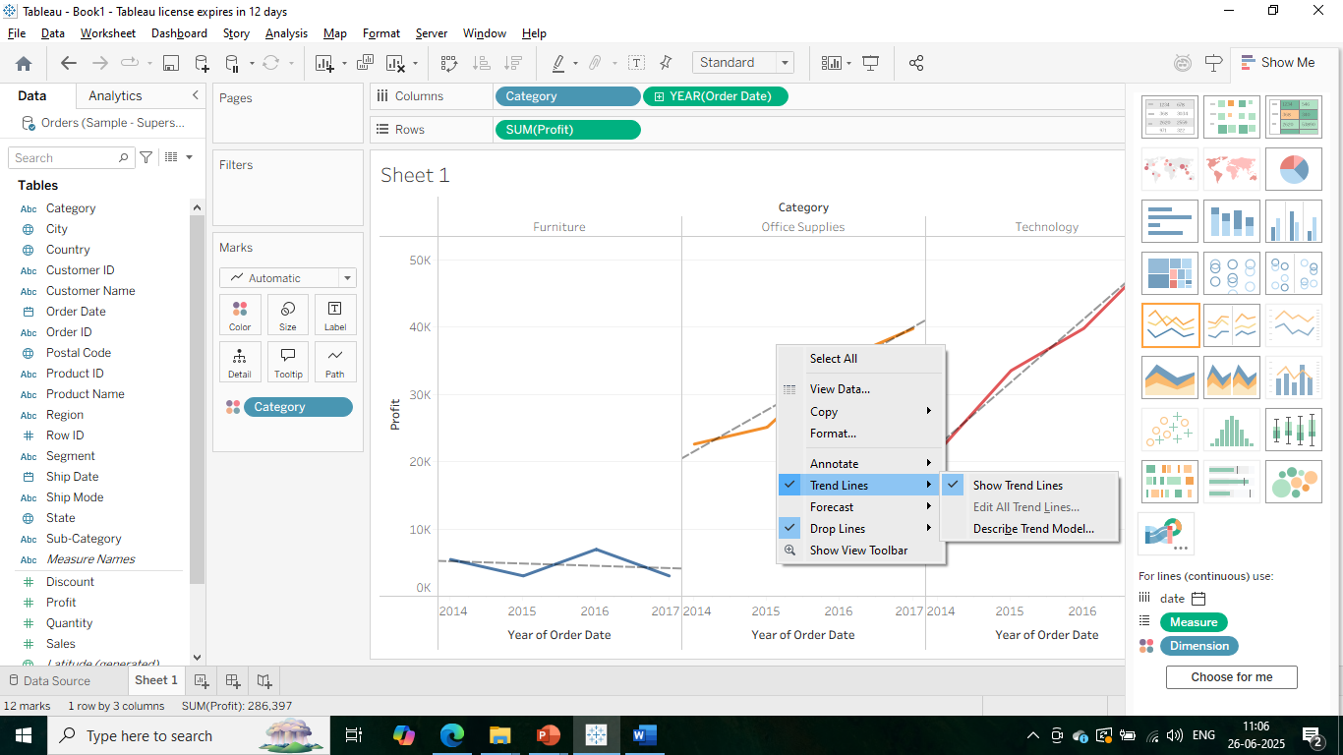
Step12) We selected the line chart option of trend lines to see the deviation from normal for worksheet 1.

Slide 13
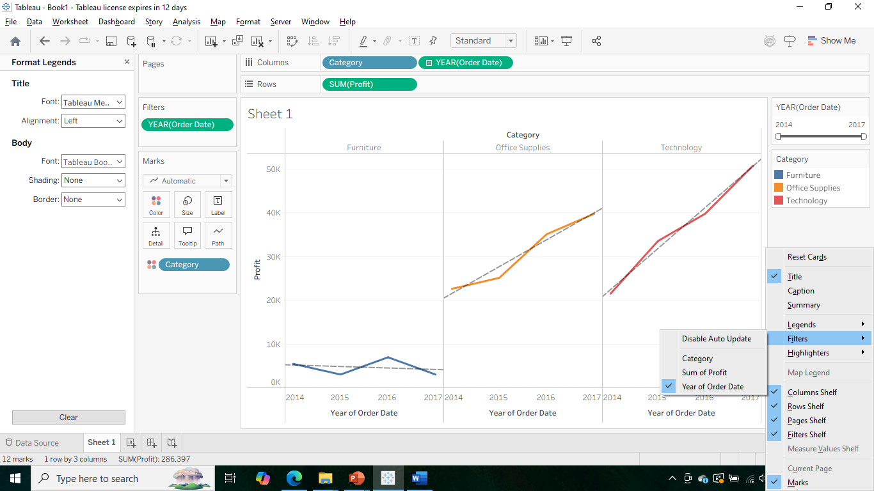
Step13) We created order date (Year) as a filter value.

Slide 14
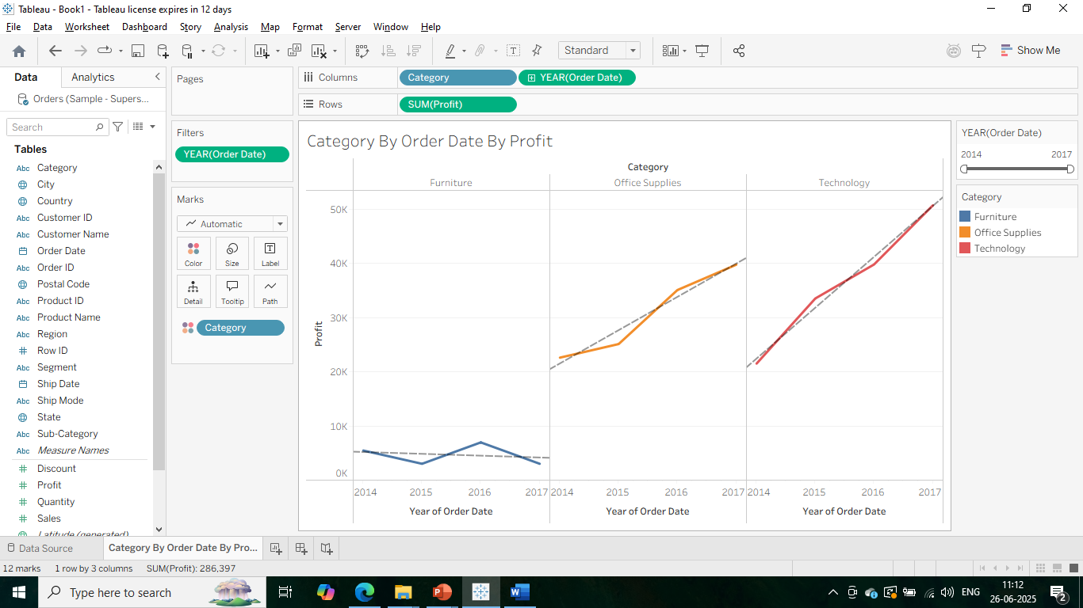
Step14) We named the worksheet1 as Category BY Order Date By Profit.

Slide 15
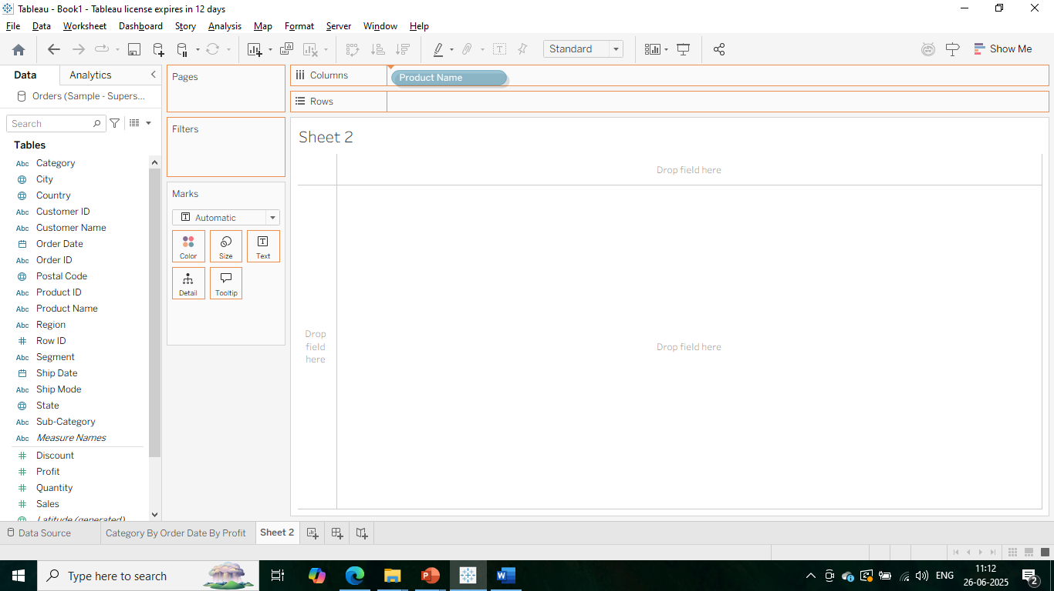
Step15) We dragged Product name to columns in worksheet 2.

Slide 16

Step16) We dragged Quantity to rows in worksheet 2.

Slide 17
Step17) We dragged Quantity to rows in worksheet 2.

Slide 18
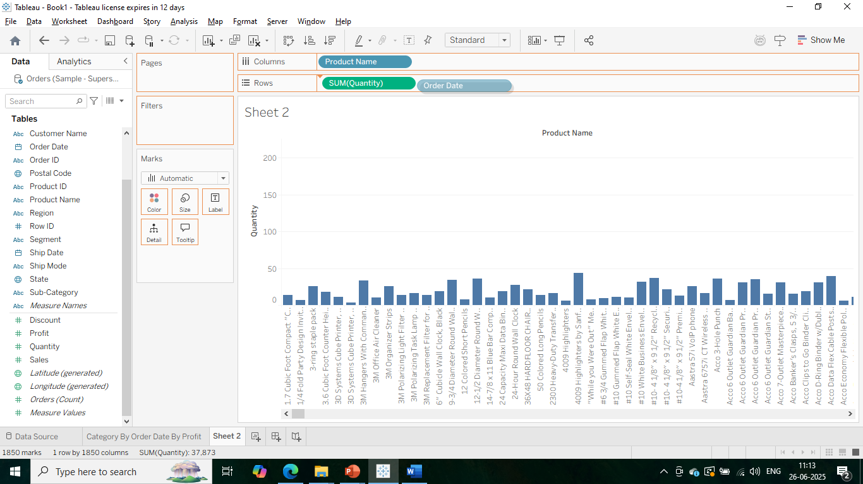
Step18) We dragged order date to rows in worksheet 2.

Slide 19
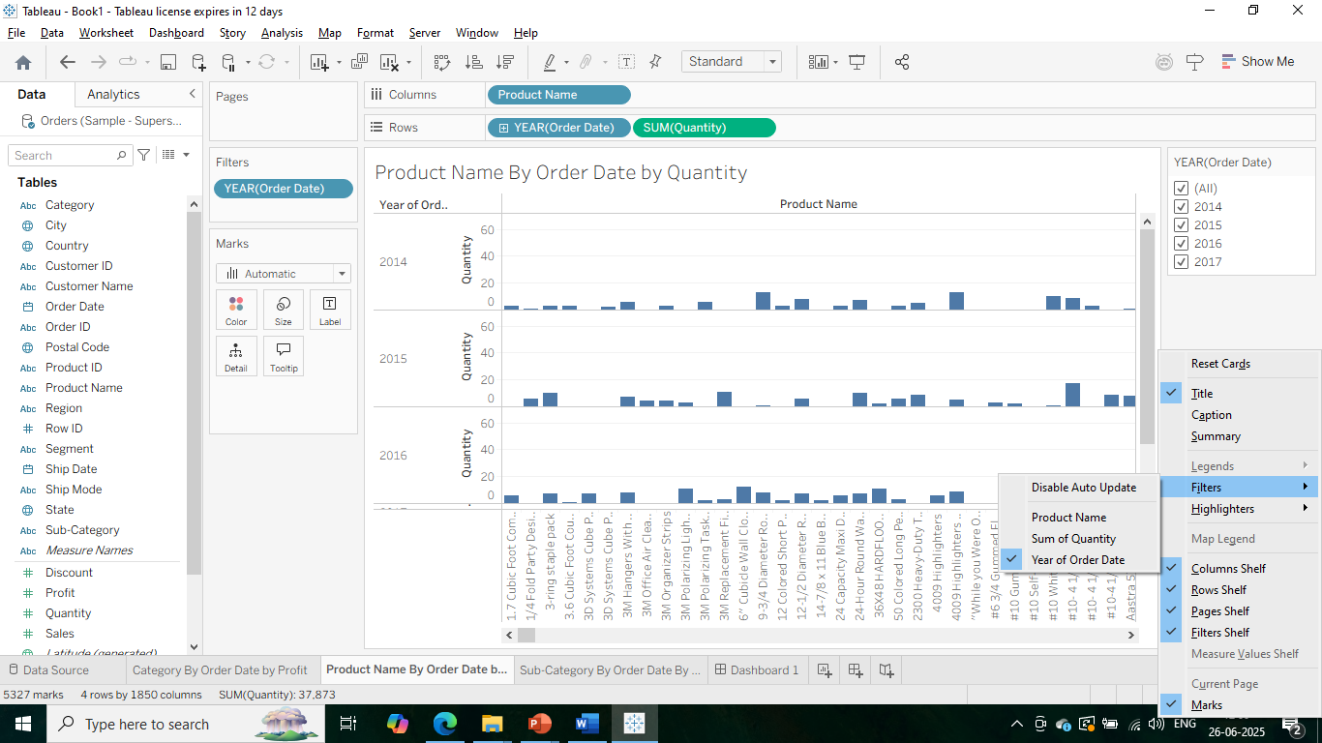
Step19) We created order date (Year) as filters in worksheet 2.

Slide 20
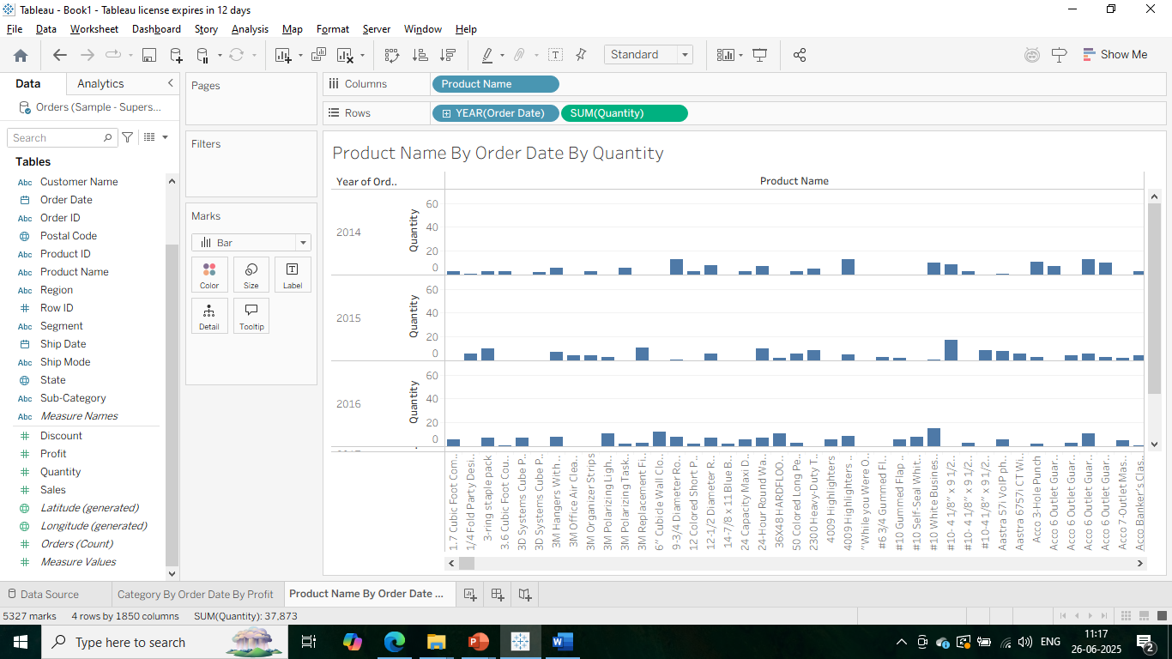
Step20) We named Product name By Order date By Quantity for worksheet 2.

Slide 21
Step21) We named Product name By Order date By Quantity for worksheet 2.

Slide 22

Step22) We started creating worksheet 3.

Slide 23
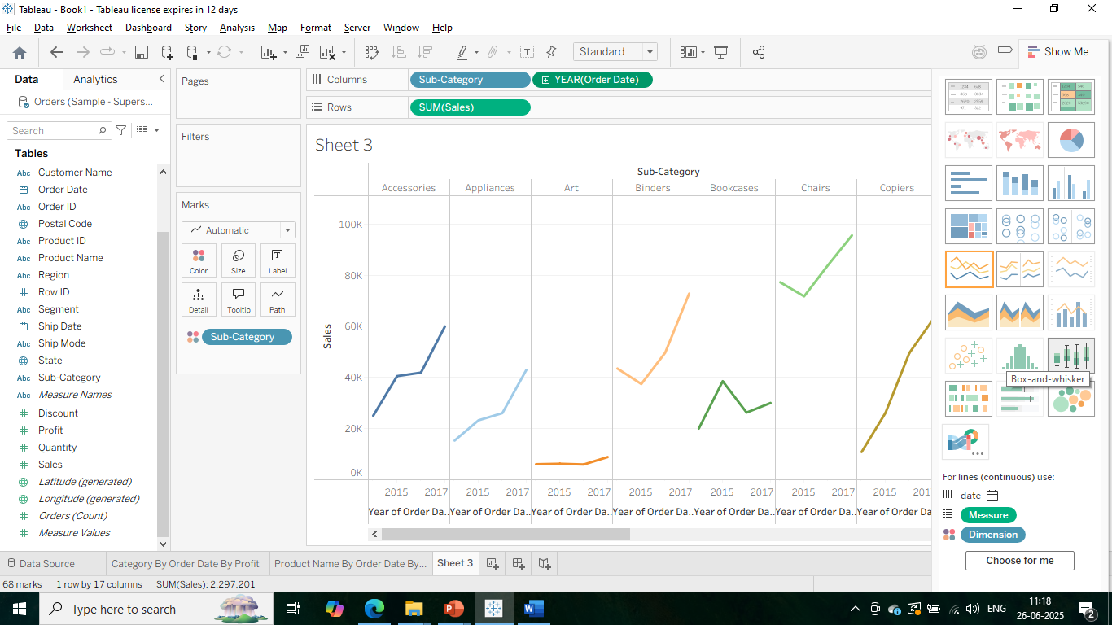
Step23) We dragged Sub-Category and Order Date to columns and Sales to the rows in worksheet3.

Slide 24
Step24) We selected line chart for worksheet3.

Slide 25
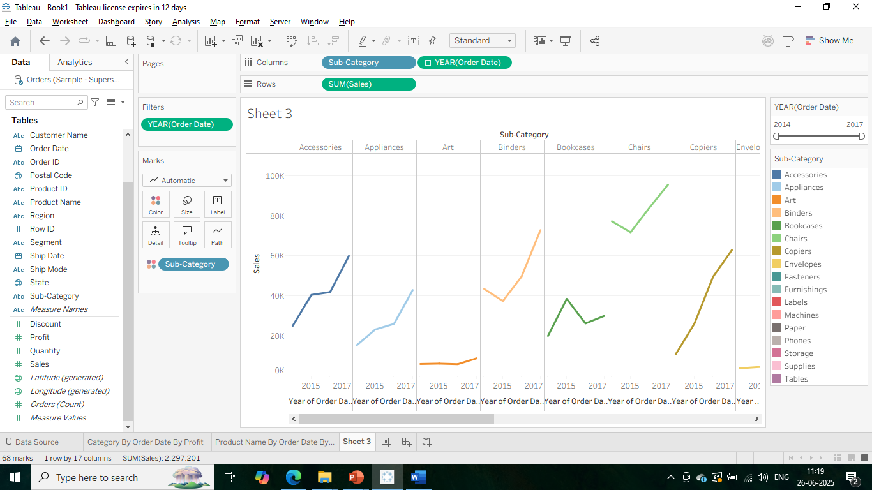
Step25) We selected Order date (Year) as filter value for worksheet3.

Slide 26
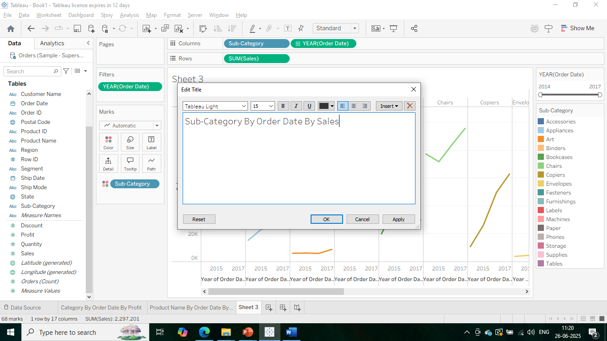
Step26) We named Sub-Category By Order Date By Sales for worksheet3.

Slide 27
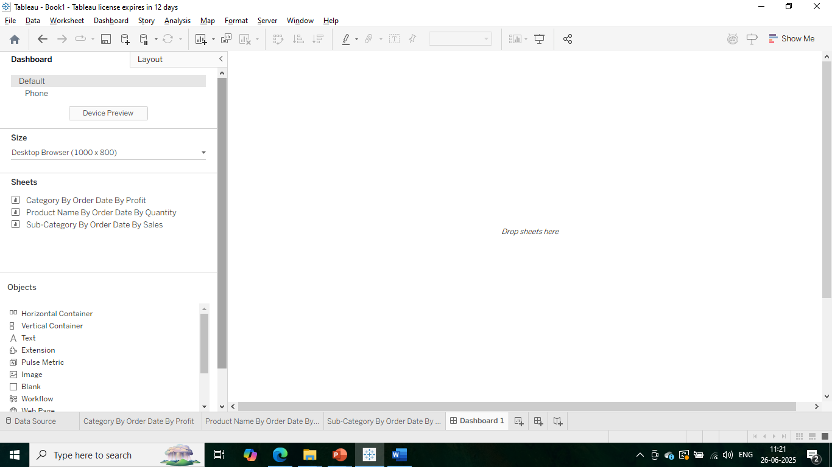
Step27) We created a new dashboard for all three worksheets. Those 3 worksheets are getting displayed.

Slide 28
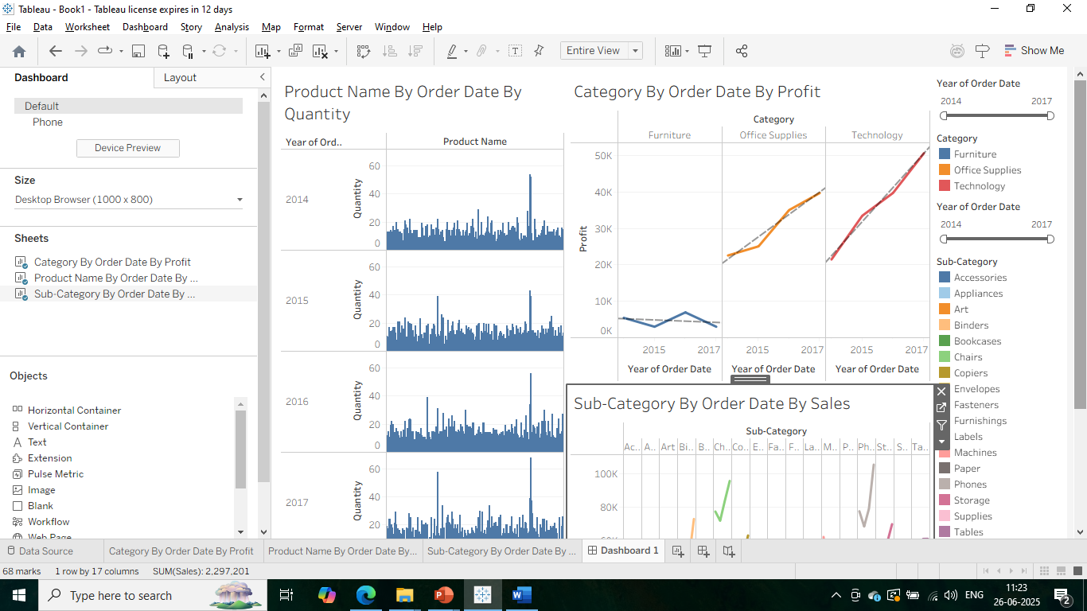
Step28) All three worksheets are dragged to the work area in dashboard.

Slide 29
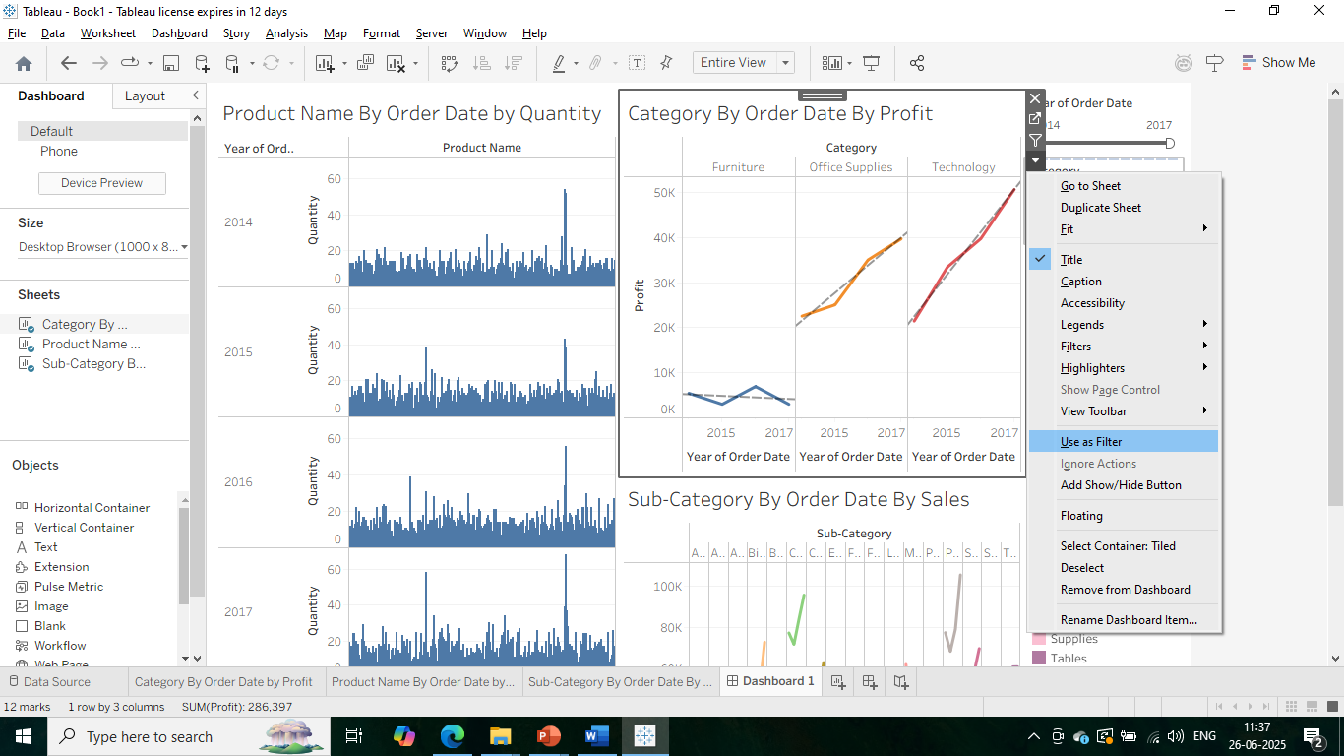
Step29) Go to use as a filter value option for worksheet 1 to make it dynamically changed with other sheets as well..

Slide 30
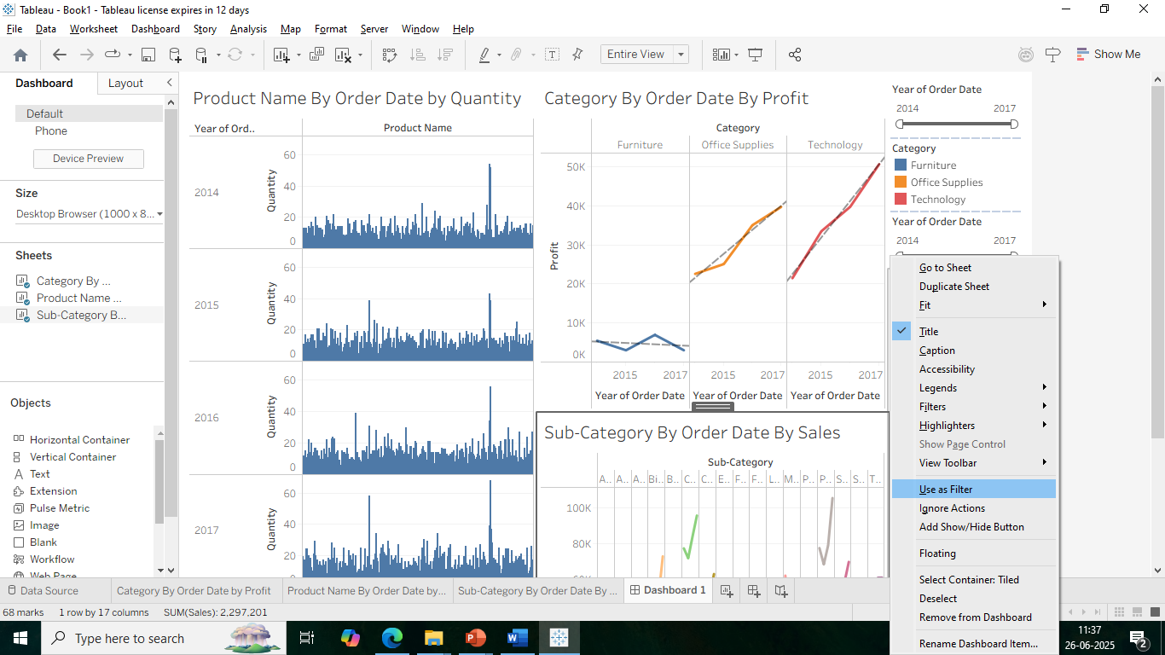
Step30) Go to use as a filter value option for worksheet 3 to make it dynamically changed with other sheets as well..

Slide 31
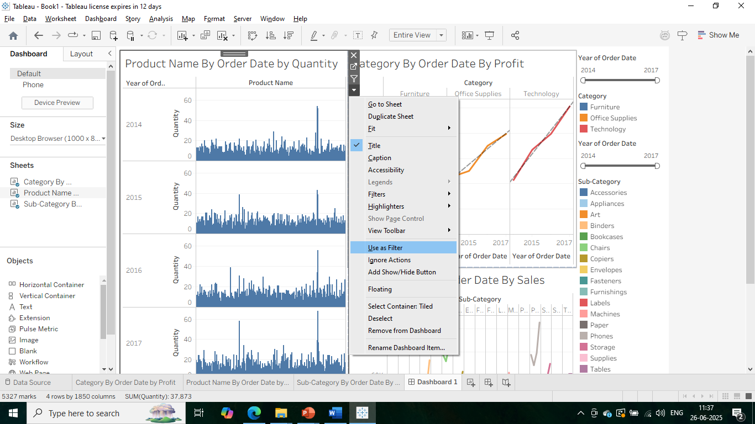
Step31) Go to use as a filter value option for worksheet 2 to make it dynamically changed with other sheets as well..

Slide 32
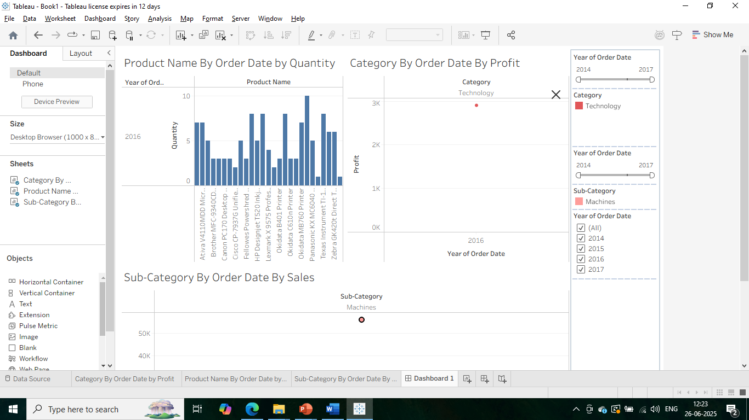
Step32) When we click on sub-category Machine then automatically it is showing corresponding values in other sheets.

